Slide 1



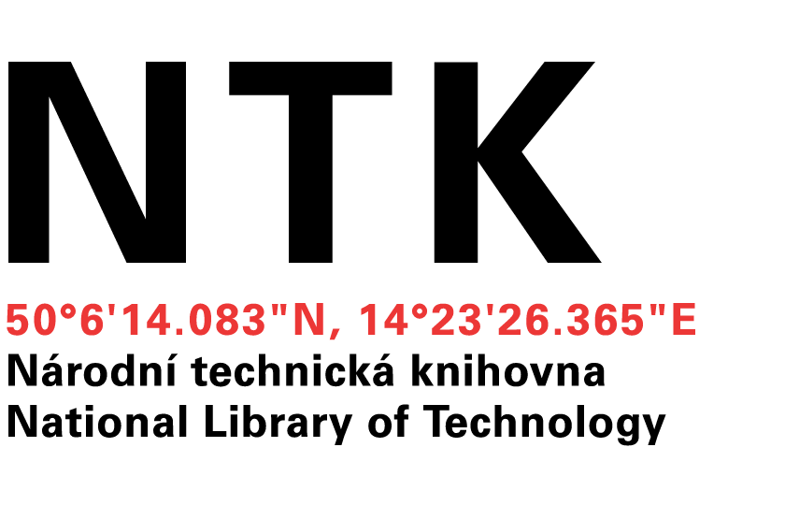
Building cross-field national data repository
Miroslav Šimek
Lukáš Koštenský
Notes:
Míra

Slide 2
Building cross-field national data repository
Scientists at universities need to store and access their data
Smaller teams have no technical background (people, hardware, software) to build the solution themselves
Several teams from various scientific fields asked us if we can provide a solution
Photo: maps.google.com
Notes:
The aim of the project is to create a proof of concept solution that could serve as a basis for a country-wide data repository

Slide 3
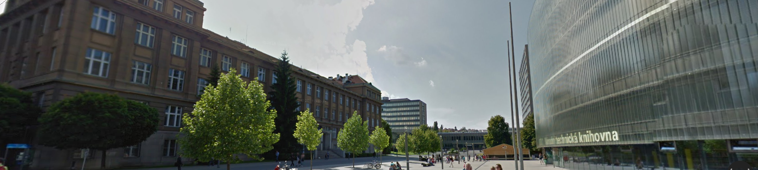
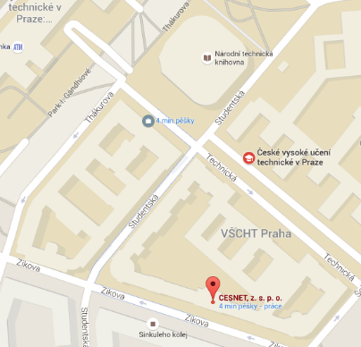
CESNET, NTK, UCT Prague?
CESNET
An association of universities of the Czech Republic and the Czech Academy of Sciences, provides infrastructure
NTK
The largest and the oldest library of science and technology provides metadata expertise
UCT Prague
Pilot implementation
Photo: maps.google.com
Notes:
CESNET
Operates and develops the national e-infrastructure for science, research and education
Provides
Networking infrastructure, Czech academic identity federation eduID.cz, Data storage (21PB of space), Collaborative environment, Distributed grid computing
Well established and trustworthy academic service provider
National library of technology
Scientists with most obscure needs
In 2013, CIS and NTK joined forces and founded ChemTK, a shared library of chemistry, sharing not only books but also e-sources and people
Department of Organic Chemistry of the Czech Academy of Sciences joined ChemTK in 2015

Slide 4
Cross-field repository
Initial groups of users
Repository for scientific data
Department of Organic Chemistry, UCT Prague
Romany Studies, Faculty of Arts, Charles University
Document repository
UCT Prague
institutional repository of articles and theses
media repository
Photo: maps.google.com
Notes:
Lukas
A scientific discipline covering sociology, anthropology, linguistics, and political science applied to Romany groups throughout the world.

Slide 5
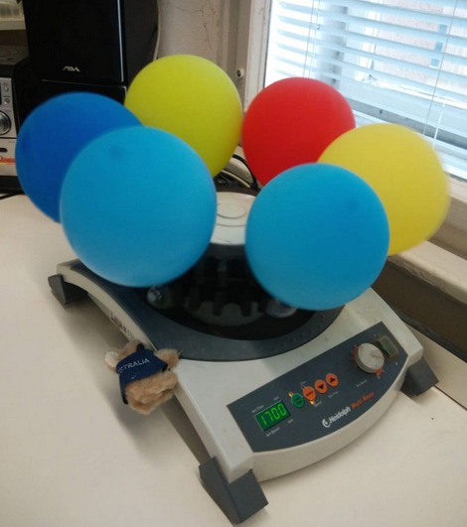

Department of Organic Chemistry
Source: department web pages
Notes:
Mira

Slide 6
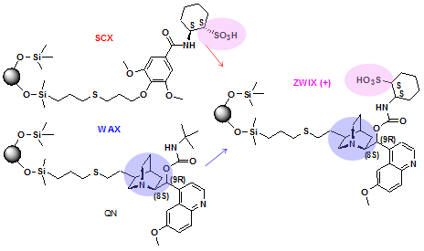
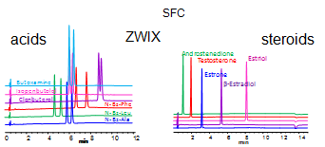
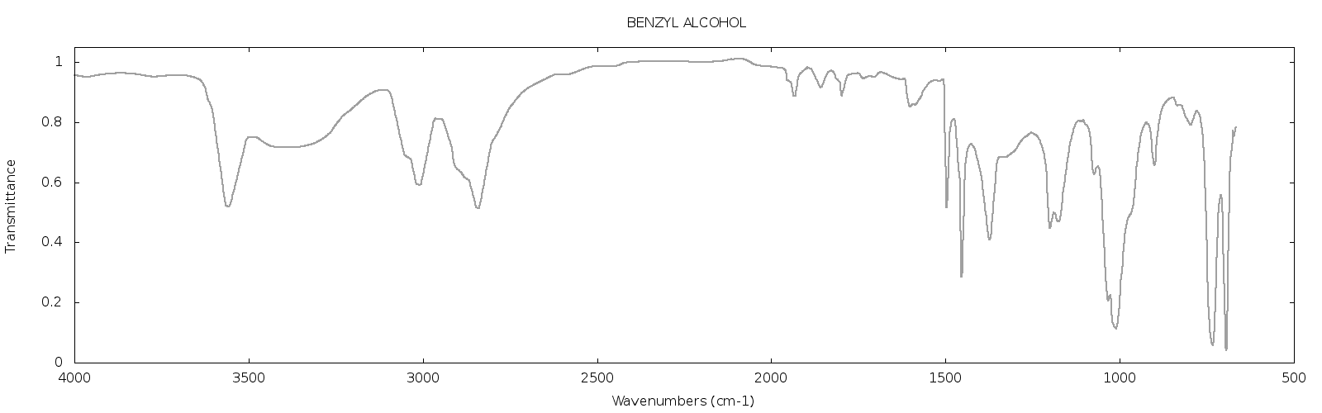
Department of Organic Chemistry
Source: bafa.vscht.cz
Notes:
During experiments
Chemical equations, chemical formulas
spectroscopic measurements, NMR, chromatography and other analytical methods

Slide 7
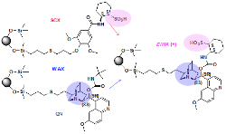
Department of Organic Chemistry
Laboratory log
Notes:
Chemical equations, chemical formulas
Carefully log the source compounds, reactions, reaction conditions and tools used, synthetized products and the data coming from spectroscopic measurements, NMR, chromatography and other analytical methods
Use different software, CIS are responsible for the web-based ones

Slide 8
Department of Organic Chemistry
Laboratory log
Computational
Chemistry
Data
(GB)
Notes:
Huge amounts data coming from computational chemistry, where chemical properties reactions are simulated in silico

Slide 9
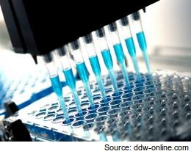
Department of Organic Chemistry
Laboratory log
Computational
Chemistry
Data
(GB)
Notes:
Results from high-throughput screening

Slide 10
Department of Organic Chemistry
Laboratory log
Computational
Chemistry
Data
(GB)
Data must be
Safely stored
Searchable
Available for all the team members
Notes:
Data available for all the team members, regardless of their geographical location, international collaboration
Safe, backed up – CESNET provides necessary infrastructure

Slide 11
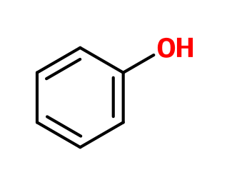
Department of Organic Chemistry
Make sure that the data are searchable
Not a simple text metadata-based search
Find data about chemical compounds with substructure
Find all data containing a sharp peak in IR spectrum in the region of 2500-3000 cm⁻¹
Notes:
Phenolic group
Reciprocal centimeters

Slide 12
Department of Organic Chemistry
Keep the data private, reasons
Pending article about the reactions/compounds/data (publish or perish)
Patent claims
Data coming from the Laboratory of New Psychotropic Drugs and their results can’t be published in detail at all
Publish and open data later when the above issues are solved
Notes:
Experience of our scientists: If data are published sooner, scientists from Asia are able to duplicate the work and publish in predatory journals in two weeks.

Slide 13
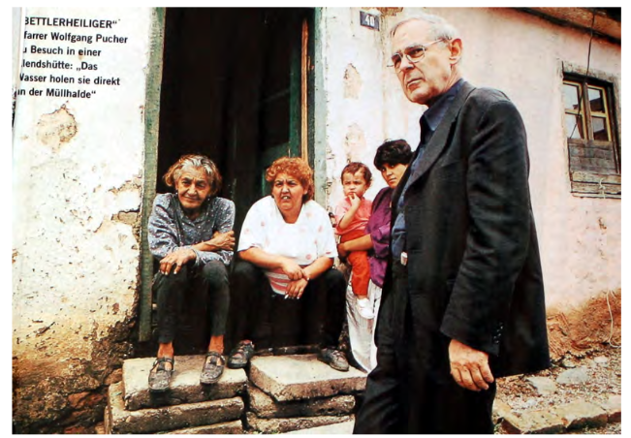
Romany Studies, Faculty of Arts, Charles University
Source: Multi-disciplinary approaches to Romany Studies,
CEU 2007-2009
Notes:
Lukáš

Slide 14
Romany Studies, Faculty of Arts, Charles University
Need to store recordings of interviews with Roma people from the Czech Republic and Slovakia together with different searchable metadata
Technical (where, when, data format, …)
Personal (who, personal relations, …)
Transcriptions, interview topics and summaries, tags, …
Problems:
Both data (recordings) and metadata contain personal information that should be visible only for the team members
Some parts of the recordings may contain descriptions of activities that could not be disclosed at the moment, should not be available even to the team but might be disclosed later

Slide 15

Romany Studies, Faculty of Arts, Charles University
From the data point of view, one resource (in this case a video recording) should have several manifestations:
Full version, archived but not available to anyone but the author

Slide 16
Romany Studies, Faculty of Arts, Charles University
From the data point of view, one resource (in this case a video recording) should have several manifestations:
Full version, archived but not available to anyone but the author
Version with some of the information stripped/blackened for the team members

Slide 17
Romany Studies, Faculty of Arts, Charles University
From the data point of view, one resource (in this case a video recording) should have several manifestations:
Full version, archived but not available to anyone but the author
Version with some of the information stripped/blackened for the team members
Even more stripped version for public use

Slide 18
Romany Studies, Faculty of Arts, Charles University
For metadata
Highest protection: SSN and other person identifiers
Medium protection: date of birth
No protection: age
The sets of data and metadata with a given level of protection changes in time

Slide 19
Comparison
 | Chemists | Romany Studies | Classical libraries
Data formats | Mainly specialized data formats: Molecules, reactions, spectra, other measurements | Mainly annotated multimedia: Videos, metadata about people, personal relations | Classical DCTerms as you know them: Title, Author, Abstract, …
Search | Substructure search, search by features in graphs, in metadata ann. | Searching in metadata annotations, transcriptions, … | Searching in metadata annotations
Data amounts | Huge (in case of computational chemistry) | Large | If not storing digitized data, moderate
Security | Very well defined and enforced | Very well defined and enforced, to the level of single metadatum | “Everything should be public, open access is the goal”
Data entry | “Do not bother me with that” | “I know I have to add transcriptions” | Metadata specialists entering info

Slide 20
Our Quest
Data repository containing diverse data and associated metadata and providing customizable UI for searching, viewing and basic editing the data
Easy to use tools for data filling
For chemistry, automatically send laboratory data to the server, run algorithms on measured data to identify and index search features
For Romany studies, have a mobile application for audio/video capture together with tagging and transcription tools, sending the data directly to the repository
Notes:
Míra

Slide 21
Architecture
UI layer based on Django
Data access layer
Repository backend
Per-meta security
Search backend
State control
Automatic
tasks
Metadata view
Metadata view
Model definition
Model definition
}
}
HTML
Python

Slide 22
Cross-field repository
Repository backends
DSpace
Invenio
Fedora
Search engines
SOLR
Elastic Search
Programming language
Python/Java
Photo: maps.google.com
Notes:
Lukáš

Slide 23
Cross-field repository
Current status
Implemented proof of concept – institutional repository of UCT Prague which is now in production
Implemented proof of concept – repository for Romany studies
Initial steps in OCH data
Enough of talking, where are the screenshots?
Photo: maps.google.com

Slide 24
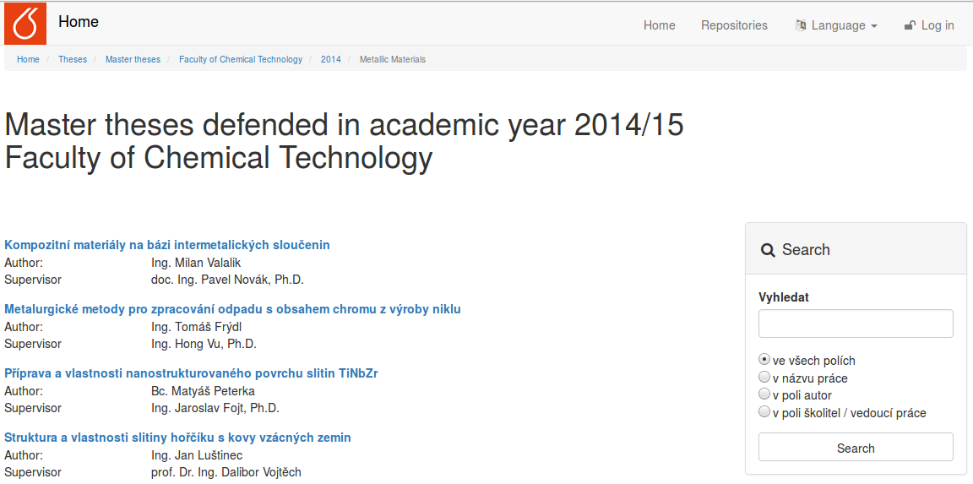
Look and Feel – classical repository
Notes:
Míra

Slide 25
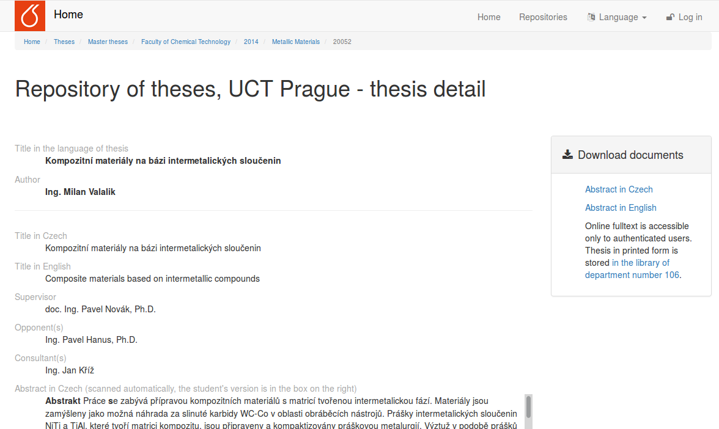
Look and Feel – classical repository

Slide 26
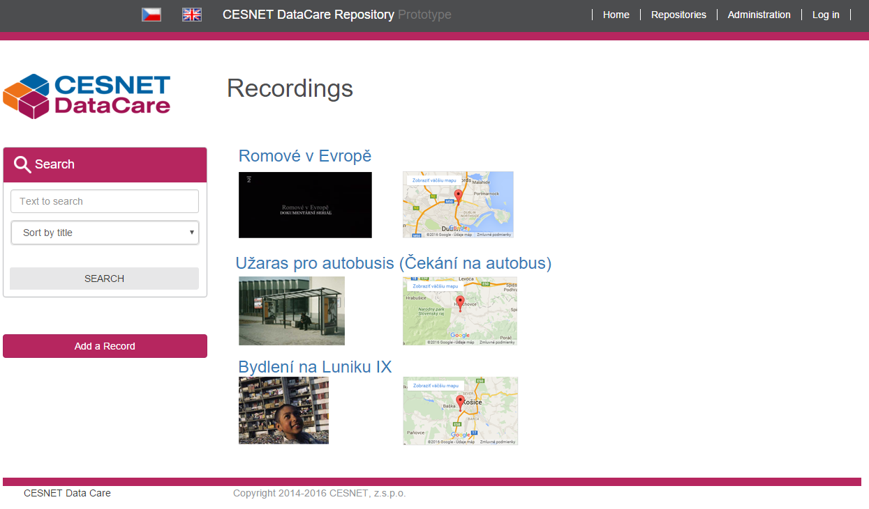
Look and Feel – Romany studies
Notes:
Lukáš

Slide 27
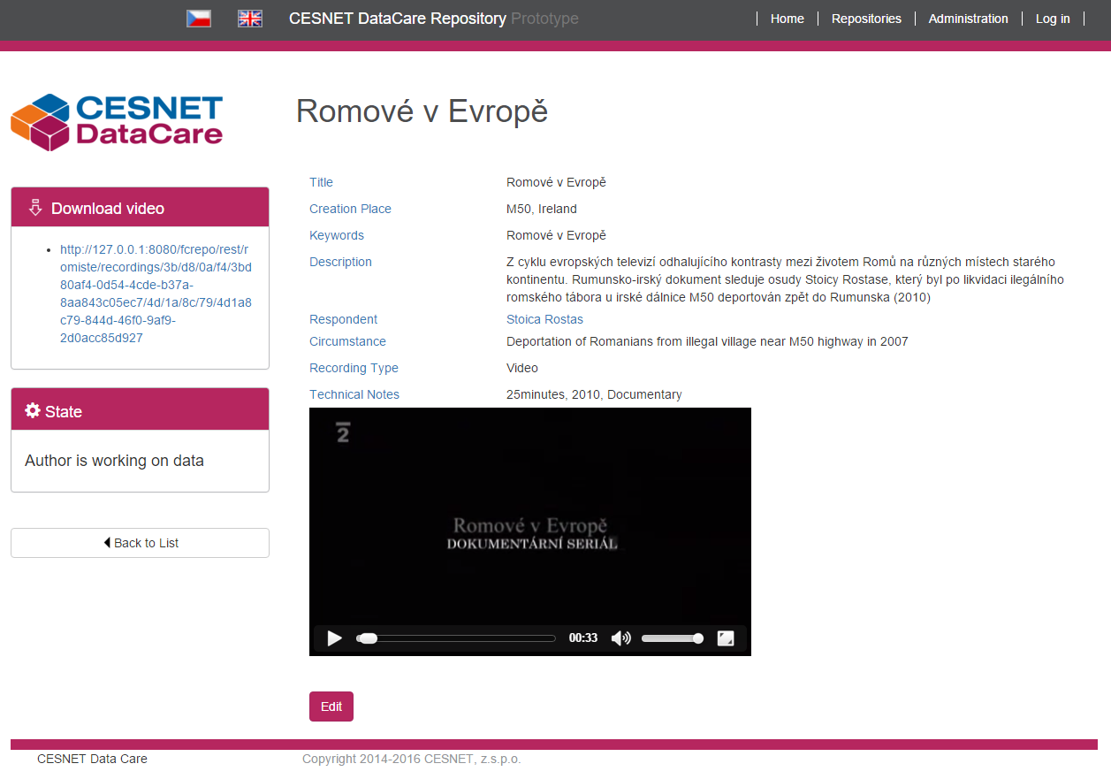
Look and Feel – Romany studies

Slide 28

Look and Feel – Romany studies

Slide 29
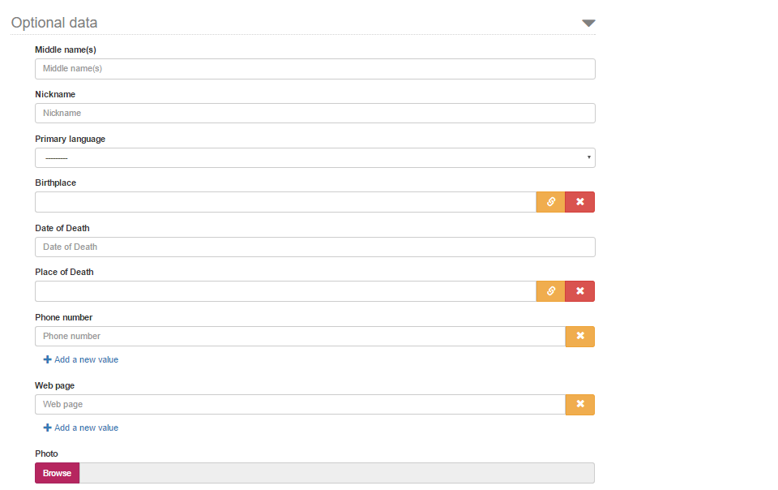
Look and Feel – Romany studies

Slide 30
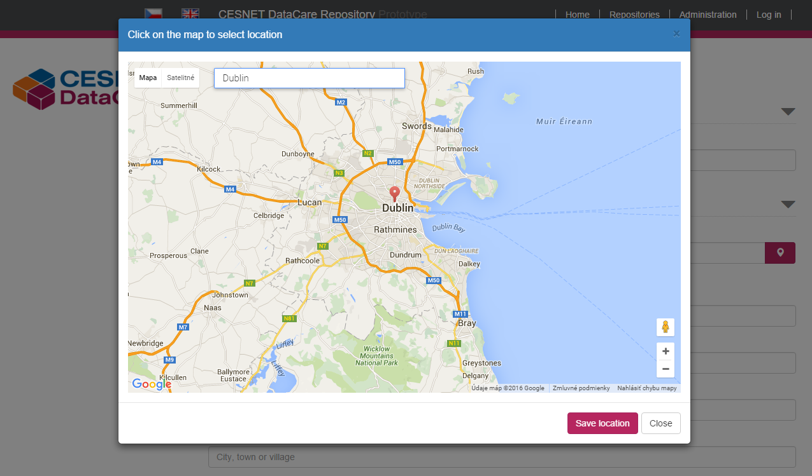
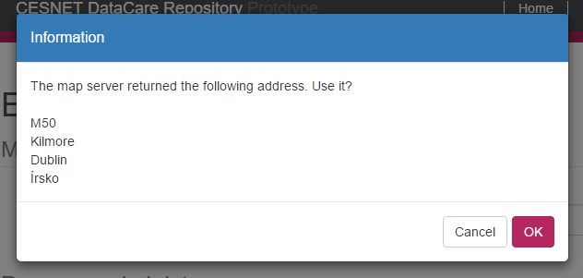
Look and Feel – Romany studies

Slide 31
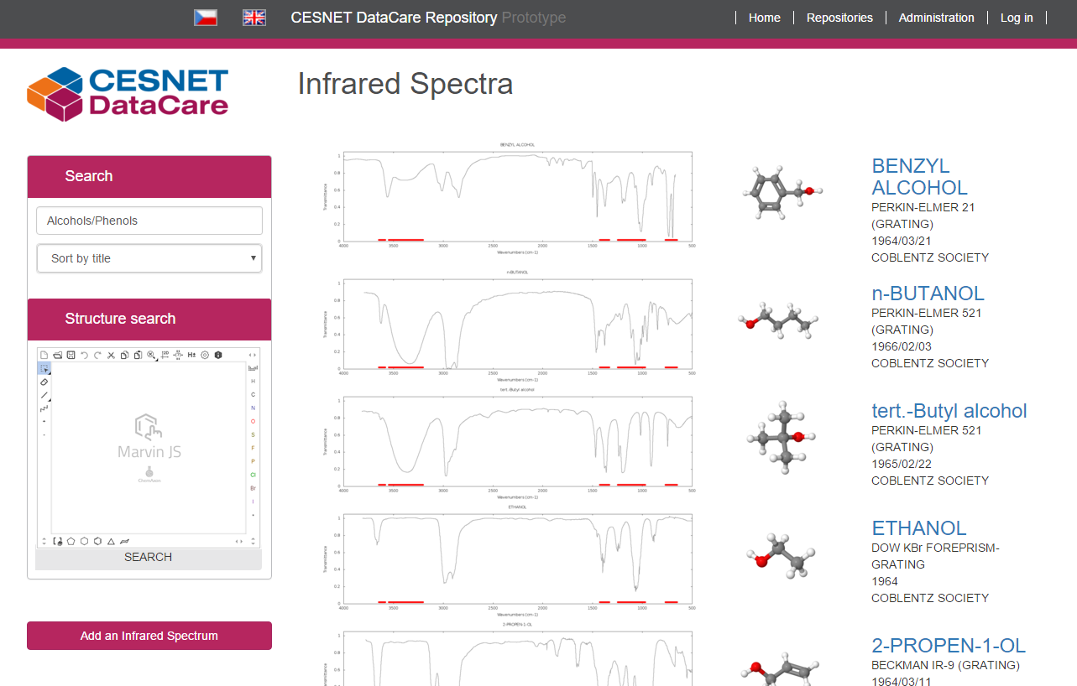
Look and Feel – Spectroscopic data

Slide 32
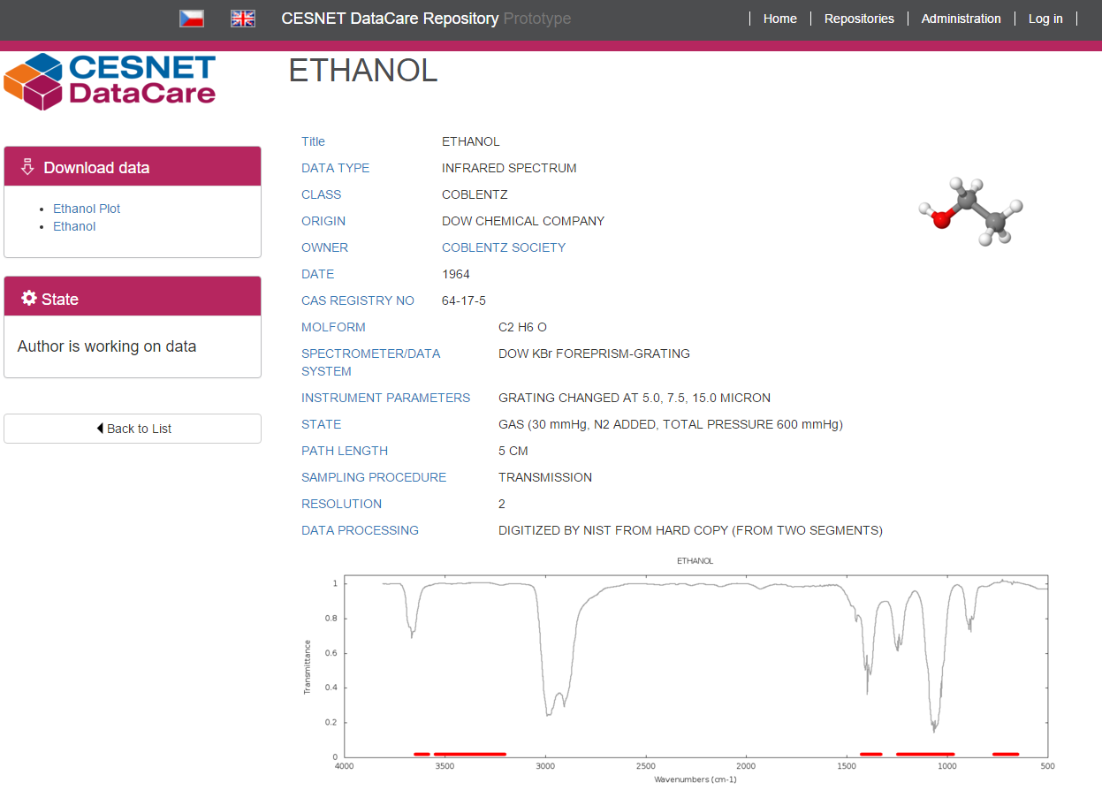
Look and Feel – Spectroscopic data

Slide 33
Cross-field repository
This year
Finalize repository for Romany studies
Finalize proof of concept for OCH data
Start working on media repository at UCT Prague and its connection to e-learning and online teaching materials
Polishing codebase and making it opensource so that other users could built specialized UIs on top of it
Working on standards adoption, cooperation with other Fedora users
Following years
Other scientific fields, perhaps turning it into a national repository of scientific data
Photo: maps.google.com
Notes:
Mira

Slide 34
Cross-field repository
Lessons learned so far
In CR: There is still aversion against centralized solutions, but after explanation scientists see the benefits and are willing to participate
Customizable resource state, approval and permissions are the must
Do not start your talk with scientists (at least chemists) with “Open data”
Even the most pro-open ones do not understand that open data does not mean open from the beginning
Customizable resource state, approval and permissions are the must
Photo: maps.google.com
Notes:
Mira
even when they are backed by CESNET

Slide 35
Thanks
Ing. Jan Horníček
Mgr. Jan Pokorný
Bc. Michal Strnad
RNDr. David Antoš, Ph.D.
PhDr. Jan Červenka, Ph.D.

Slide 36





Special thanks
bleach | inflection | isodate | pyparsing
django-bootstrap-pagination | rdflib | requests | python-dateutil
bootstrap | jquery | bootstrap3-dialogs | Google APIs

Slide 37
Architecture end of the year
CESNET DataCare Repository
Custom templates
Built-in templates
Typed API
Untyped API
State engine
Field
AC
Fedora
Metadata
Data
WebAC
States
Custom data
definition
Custom templates
Data add-ons
Custom data definition
Data add-ons
Built-in datatypes
Schema mgmt
Elastic Search
House keeping tasks and data conversion

Slide 38
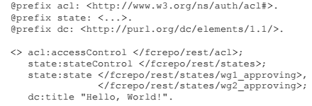
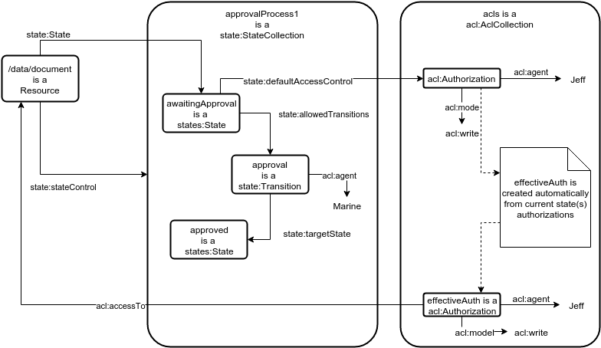
Architecture - states

